Slide 1
BREWERY SALES FORECASTING
BIA-678 WS
Team D
Shaun Mendes
Bhushan Vinod Karande

Slide 2
Table of Contents
Objective
Data Overview
Data Preprocessing
Feature Engineering
EDA
Model Details
Model Performance
Cloud Architecture
Issues
Cluster Configuration
Scale Out
Scale Up

Slide 3


Objective
Sales Prediction: Analyze the brewery dataset to identify key factors influencing beer sales and build predictive models using Linear Regression, Decision Tree, and Random Forest algorithms.
Scaling Operations: Examine the impact of scaling up (increasing dataset size) and scaling out (expanding cluster capacity) on model accuracy and performance.
Explore factors that affect the sales the most.

Slide 4

Data Overview
https://www.kaggle.com/datasets/ankurnapa/brewery-operations-and-market-analysis-dataset/
Overview: This dataset presents an extensive collection of data from a craft beer brewery, spanning from January 2020 to January 2024. It encapsulates a rich blend of brewing parameters, sales data, and quality assessments, providing a holistic view of the brewing process and its market implications.
Datapoints: 10 Million

Slide 5
Data Overview
Feature Variables:
Batch_ID: integer
Brew_Date: timestamp
Beer_Style: string
SKU: string
Location: string
Fermentation_Time: integer
Temperature: double
pH_Level: double
Gravity: double
Alcohol_Content: double
Bitterness: integer
Color: integer
Ingredient_Ratio: string
Volume_Produced: integer
Quality_Score: double
Brewhouse_Efficiency: double
Loss_During_Brewing: double
Loss_During_Fermentation: double
Loss_During_Bottling_Kegging: double
Target Variables: Total_Sales: double

Slide 6
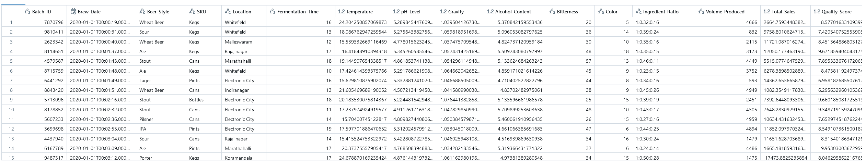
Data Overview

Slide 7
Data Preprocessing
Data Cleaning & Feature Engineering:
Drop duplicates
Impute Missing values – Drop/Replace with mean or most common category
Categorical columns – Replace with numbers or One hot encoding
Timestamp – Converting it to machine friendly. For eg: 2020-01-01 was divided into Year, Month and Day

Slide 8
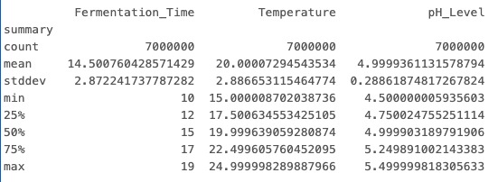
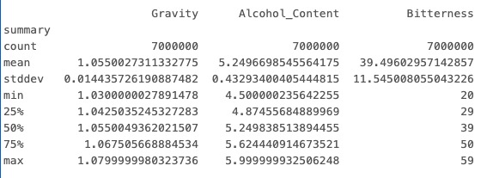
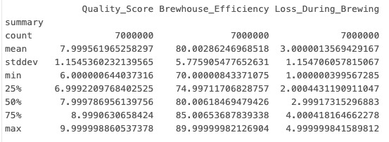
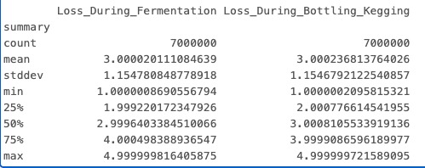
Data Preprocessing
EDA:
Continuous Variables

Slide 9
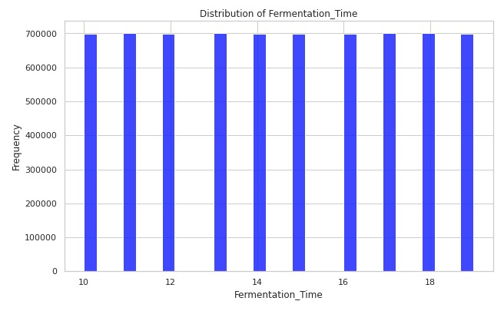
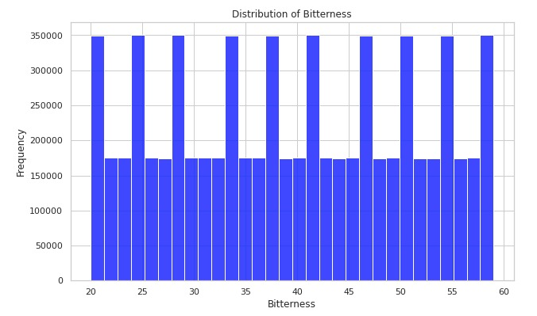
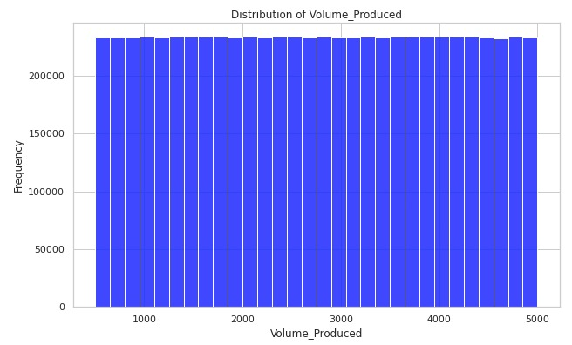
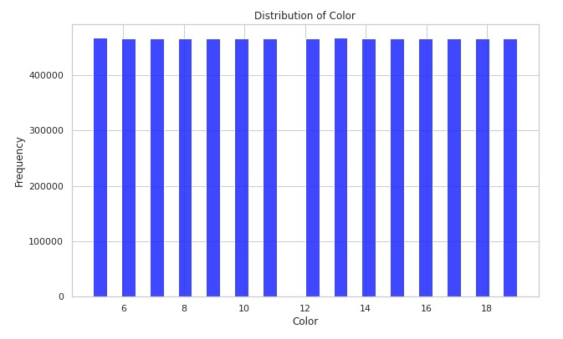
Data Preprocessing
EDA:
Categorial Variables

Slide 10
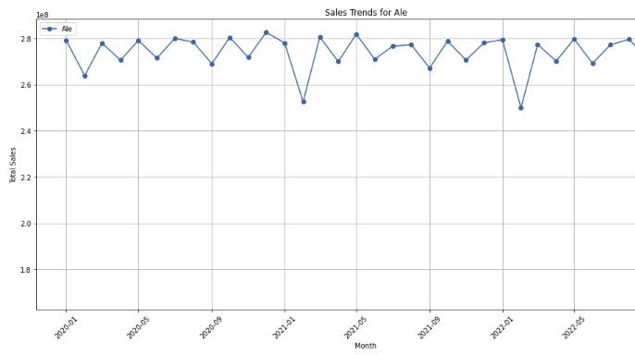
Data Preprocessing
Target Analysis: 7M Datapoints

Slide 11
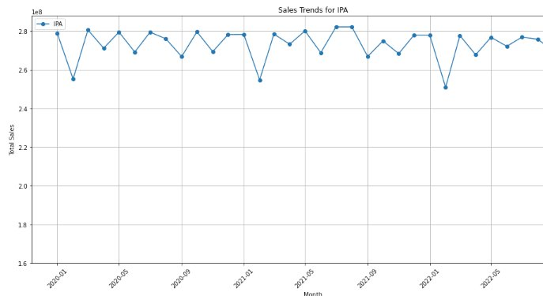
Data Preprocessing
Target Analysis: 7M Datapoints

Slide 12
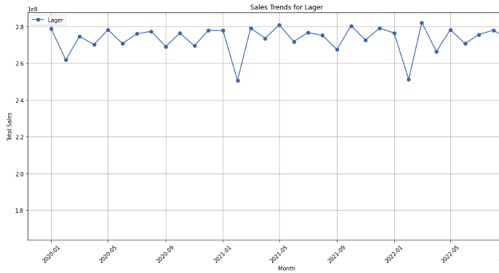
Data Preprocessing
Target Analysis: 7M Datapoints

Slide 13
Model Details
 | Model | Hyperparameters
Baseline | Linear Regression | regParam, solver
Tree | Decision Tree | maxDepth, maxBins
Ensemble | Random Forest | numTrees, maxDepth, maxBins

Slide 14
Model Performance
Model | RMSE | Hyperparameters
Linear Regression | 5486 | regParam, solver
Decision Tree | 5490 | maxDepth, maxBins
Random Forest | 5490 | numTrees, maxDepth

Slide 15




Cloud Architecture

Slide 16
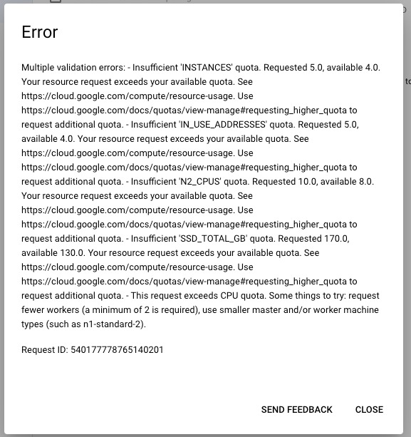
Issues
Cluster Creation Permissions
Resolution: Create IAM roles based on bucket and API availability
Scaling Up
Resolution: Maximum number of workers that could be used was 3
Scaling Out
Resolution: Split Based on Years

Slide 17
Cluster Config
Workers | Config
1 | 1 Master: 2 vCPU, 1 core, 8GB Memory 0 Worker Disk Size : 50GB each
2 | 1 Master: 2 vCPU, 1 core, 8GB Memory 2 Worker: 2 vCPU, 1 core, 8GB Memory Disk Size : 50GB each
3 | 1 Master: 2 vCPU, 1 core, 8GB Memory 3 Worker: 2 vCPU, 1 core, 8GB Memory Disk Size : 50GB each

Slide 18
Scaling Out
Workers | Linear Regression | RMSE
1 | 15mins 4sec | 5486
2 | 12mins 28 sec | 5486
3 | 10mins 8sec | 5486

Slide 19
Scaling Out
Workers | DecisionTree | RMSE
1 | 13min 23sec | 5490
2 | 11min 49sec | 5490
3 | 9mins 8sec | 5490

Slide 20
Scaling Out
Workers | Random Forest | RMSE
1 | 15min 47sec | 5490
2 | 7min 55sec | 5490
3 | 6min 1sec | 5490

Slide 21
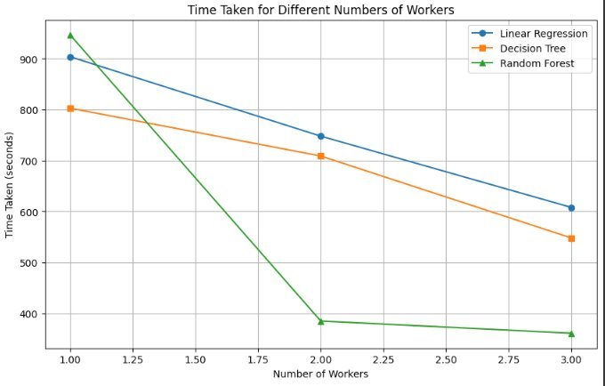
Scaling Out

Slide 22
Scaling Up
Config: 1 Master 1 Workers Model: Linear Regression
Data | Time Taken
25% | 8min 51sec
50% | 13min 42sec
75% | 14min 47sec

Slide 23
Scaling Up
Config: 1 Master 2 Workers
Model: Linear Regression
Data | Time Taken
25% | 4mins 15 sec
50% | 7 min 45 sec
75% | 10 min 15 sec

Slide 24
Scaling Up
Config: 1 Master 3 Workers
Model: Linear Regression
Data | Time Taken
25% | 4 min 5 sec
50% | 6 min 8 sec
75% | 8 min 30 sec

Slide 25
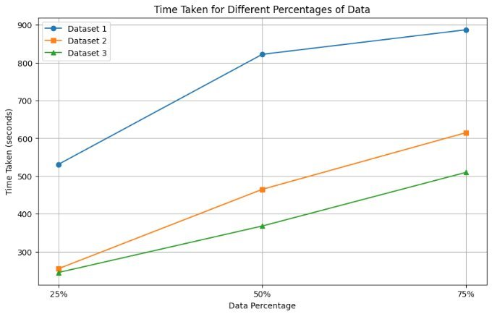
Scaling Up

